Slide 1
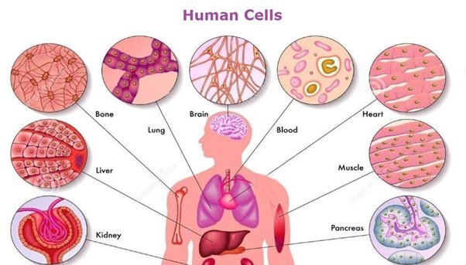
Your body is complex, so what are you made of?

Slide 2
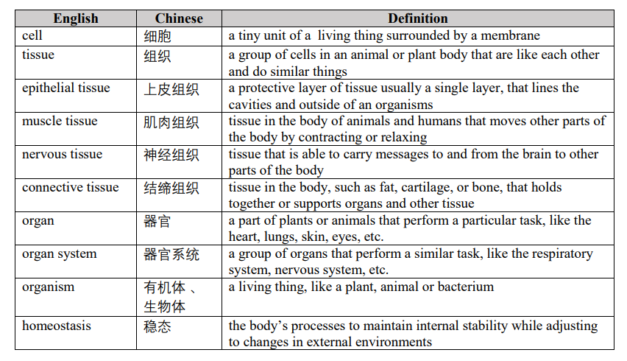

Slide 3
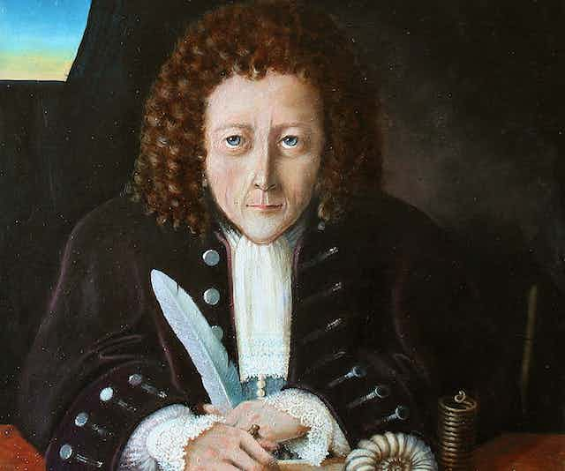
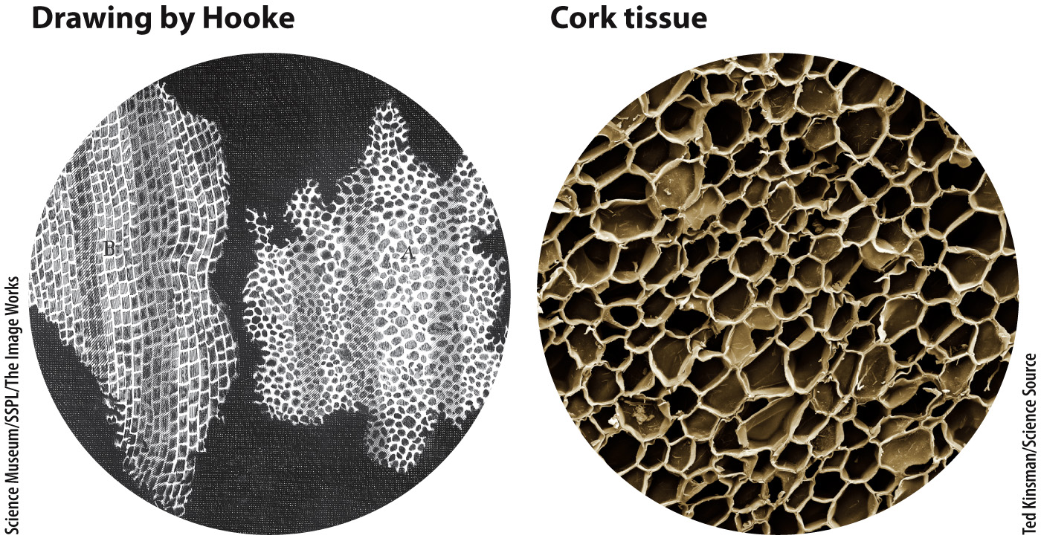
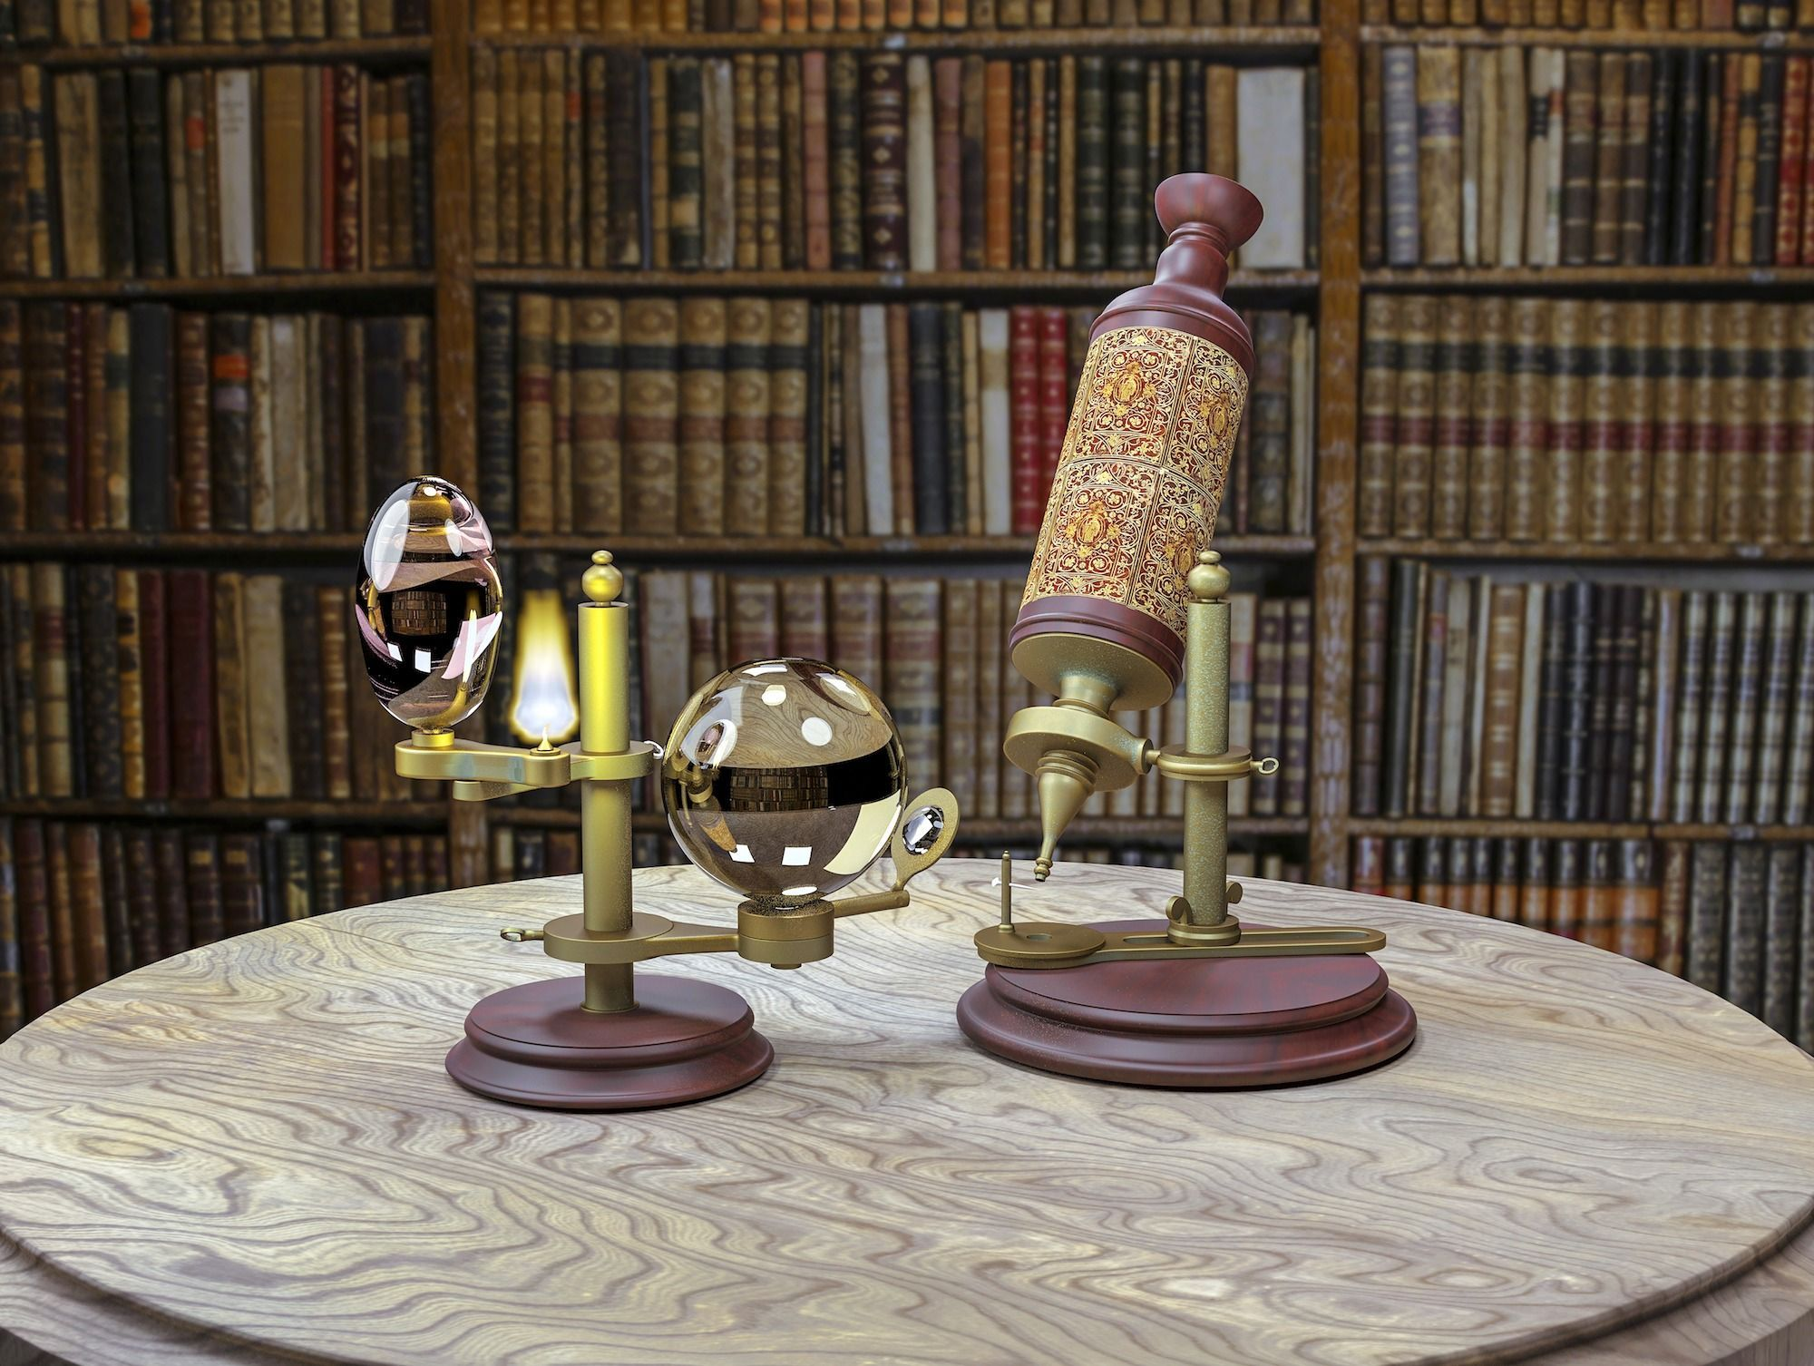
How do we know about cells?
Robert Hooke 1665
Latin word cellula = small rooms

Slide 4
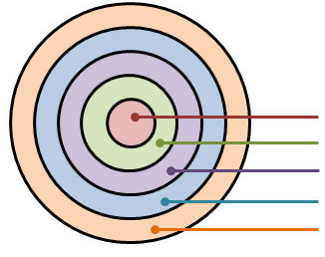
A complex organism is organized into different levels.
Similar to:
House
District
City
Province
Country
Cells
Tissue
Organ
Organ Systems
Organism

Slide 5
A complex organism is organized into different levels.
Similar to:
Student
Class
Grade
Division
School
Cells
Tissue
Organ
Organ Systems
Organism

Slide 6
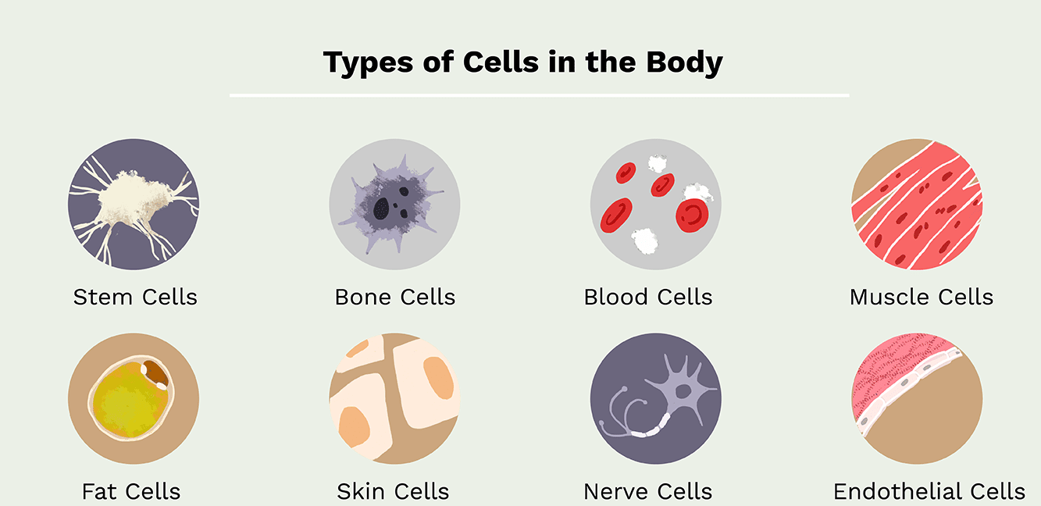
All living things are made of cells.
Cell: smallest unit of life, each with a special job

Slide 7
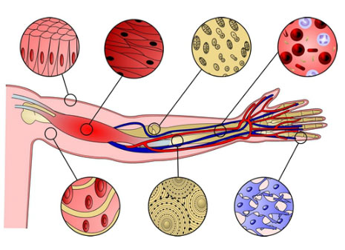
Tissue
Tissue: group of cells working together to do a job
There are 4 major tissues types (next lesson)

Slide 8
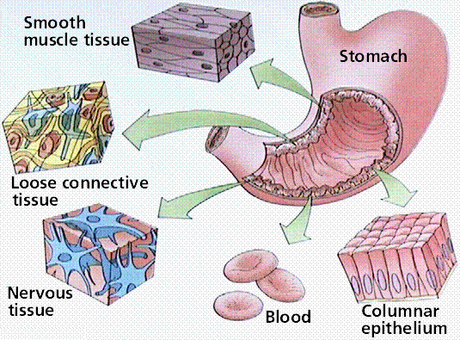
Organs
Organs: groups of tissues working together to do a job
  Ex: stomach, brain, heart, skin, liver

Slide 9
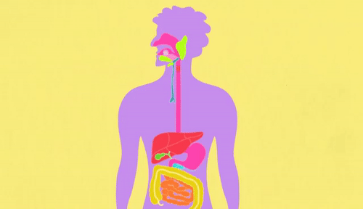
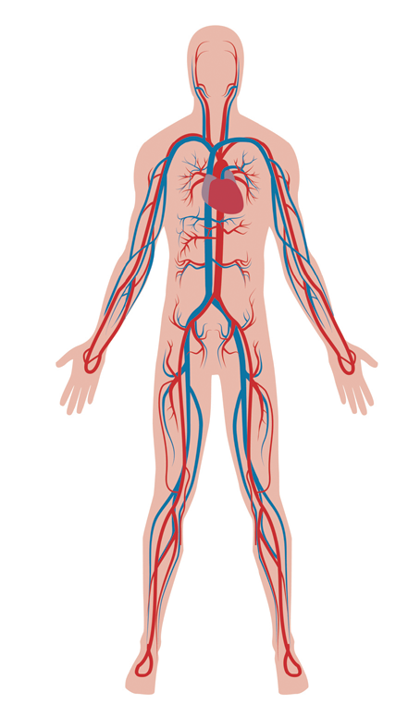
Organ System
Organ System: group of organs working together to do a job
  Ex: skeletal, digestive, and cardiovascular systems

Slide 10
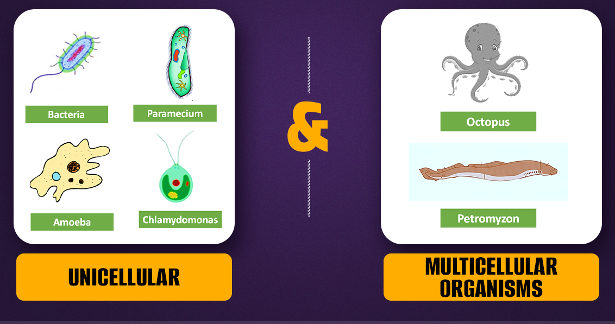
Organisms
Organism: a living thing (that has all 7 characteristics of life)
  Complex organisms are made up of systems
  Simple organisms are made up of cells

Slide 11
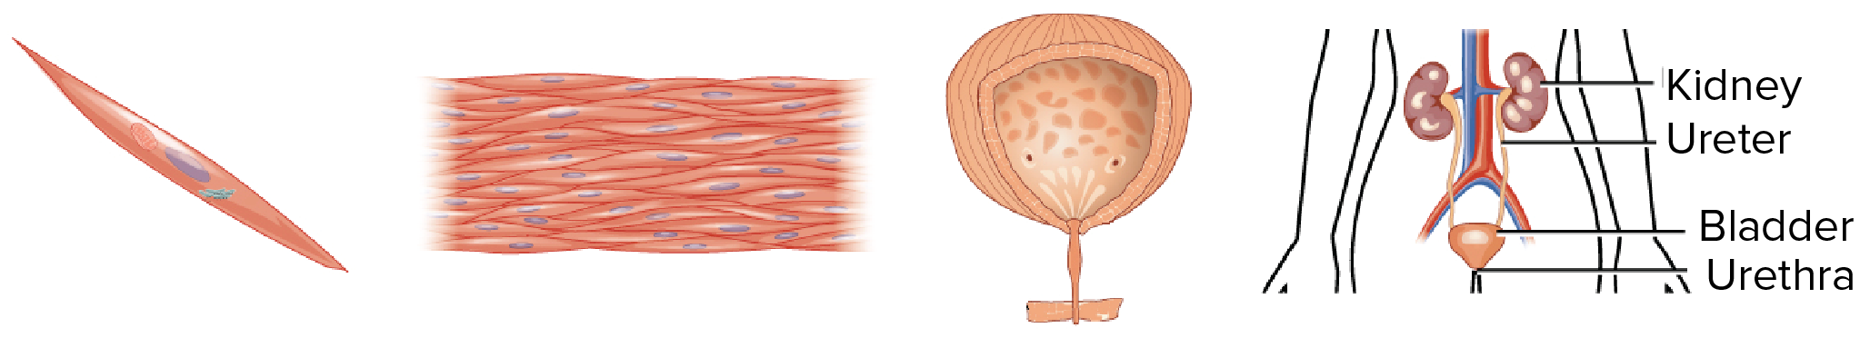
Example:
Muscle cell → (smooth) Muscle tissue → Bladder → Urinary System → Human

Slide 12
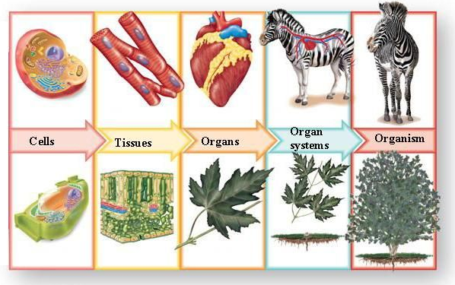
Identify and Describe:
1
2
3
4
5

Slide 13
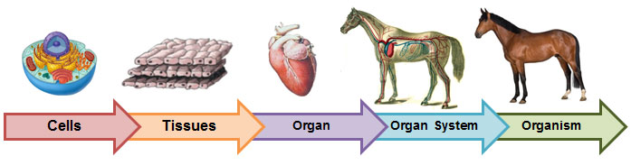
From smallest to largest what are the levels of body organization?
What is an example of each level?

Slide 15
Create this table in your notes:
Tissue Type | Function | Location

Slide 16
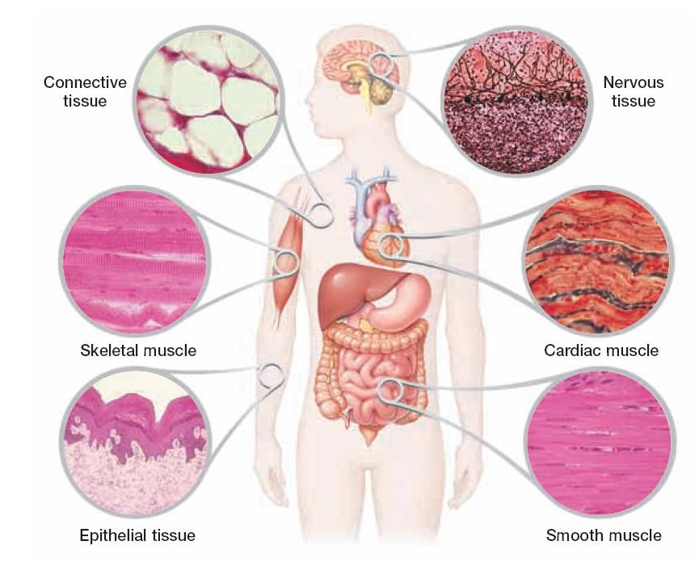
Tissue
Tissue Type | Function
Epithelial | Protection
Muscle | Movement
Nervous | Send messages
Connective | Connect, Construct, Transport

Slide 17
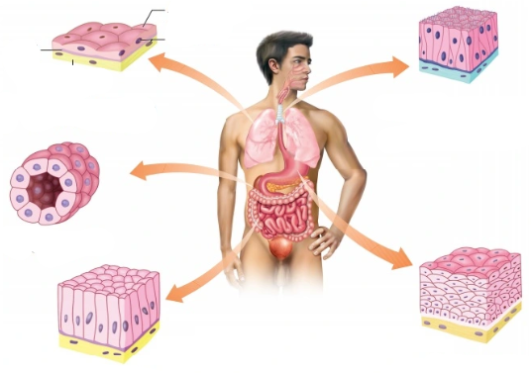
Epithelial Tissue
Protects body by covering organs or lining inside surfaces
  Ex: skin, lining of stomach

Slide 18
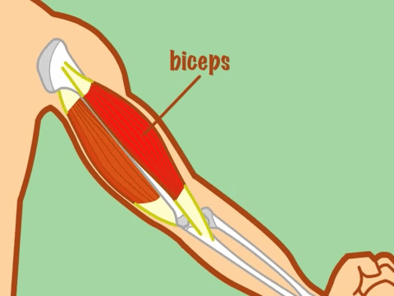
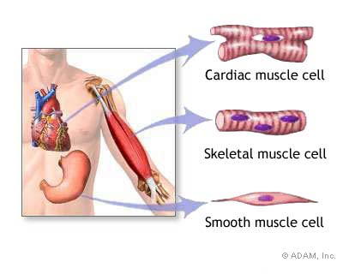
Muscle Tissue
contract and relax (shorten and lengthen) to move
  Ex: skeletal (on bone), cardiac (heart), smooth

Slide 19
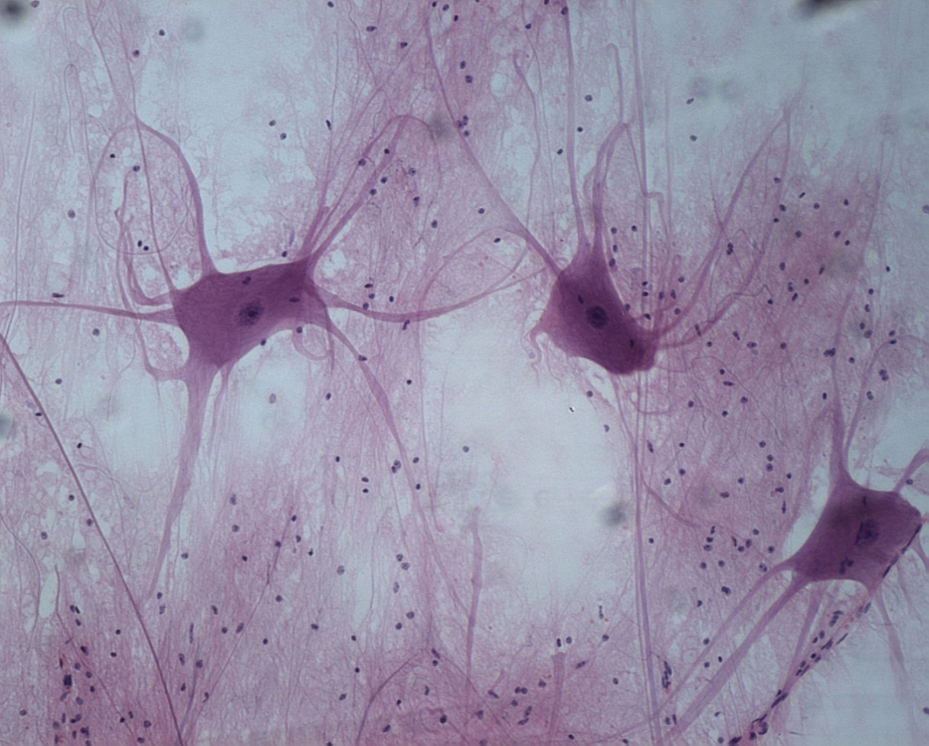
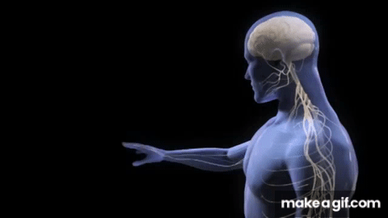
Nervous Tissue
send electrical messages throughout the body
  Ex: brain, spinal cord, nerves
Notes:
Start 6Bi

Slide 20
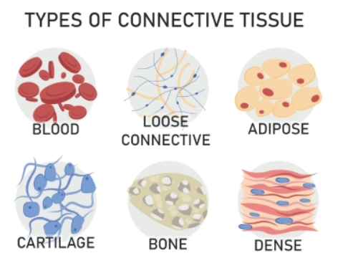
Connective Tissue
Most common tissue type
Most functions (jobs)
  Supports and give structure (bone, cartilage)
  Transport nutrients (blood)
  Hold organs together (tendon, ligament)
  Ex: blood, bone, fat

Slide 21
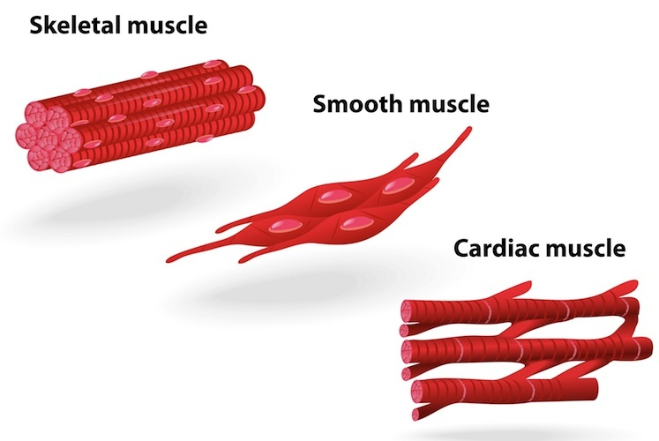
Tissue
4 Types, but each type can have different kinds as well.
Notes:
Begin with 6Br

Slide 22
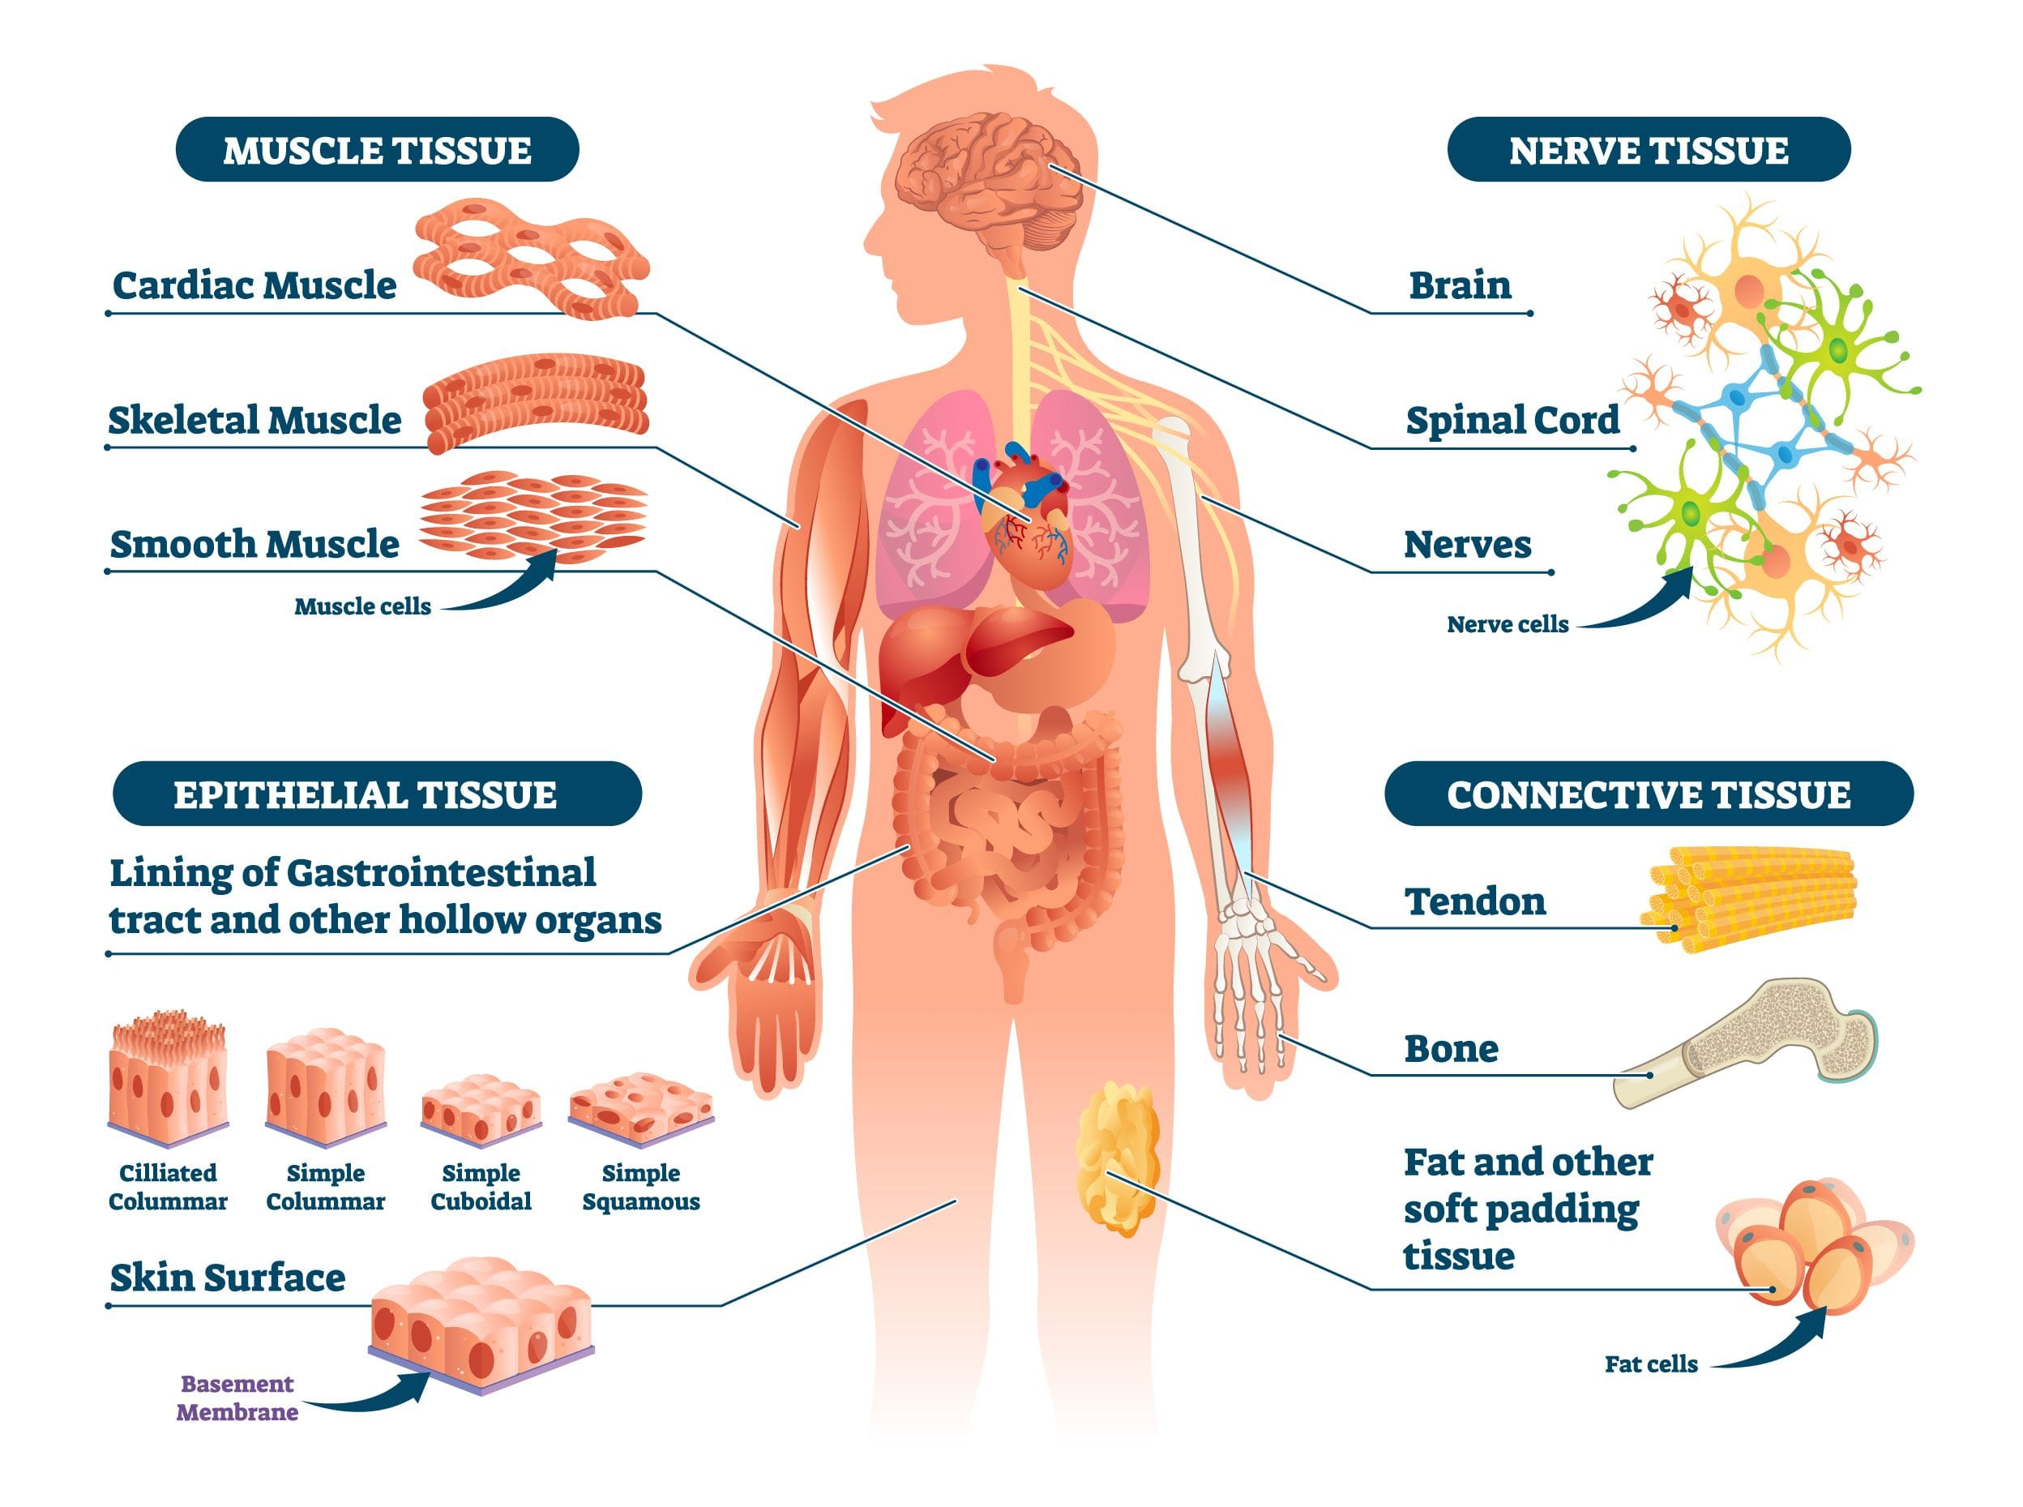
Review: Types, Functions, Examples

Slide 23
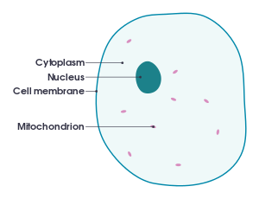
Inside vs. Outside
All living things have an internal environment separate from the outside.

Slide 24
Homeostasis
Homeostasis: ability to maintain steady internal conditions
homeo = same
stasis = stable
Examples of homeostasis: temperature, blood sugar, oxygen, water volume

Slide 25
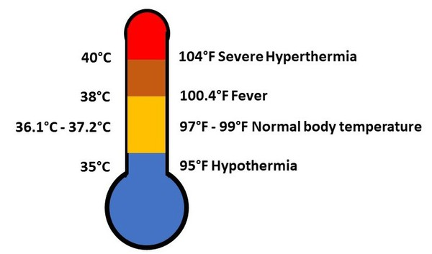
What is the body’s ideal body temperature?

Slide 26
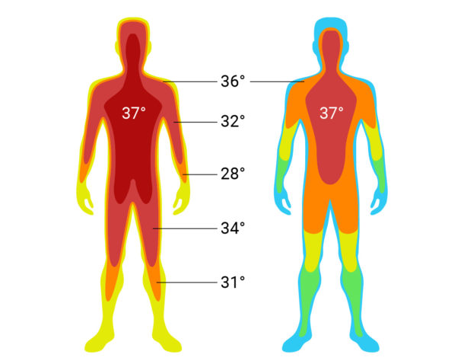
Body Temperature
Though the limbs may cool down, the main body (core) needs to stay at proper temperature to keep important body functions.

Slide 27
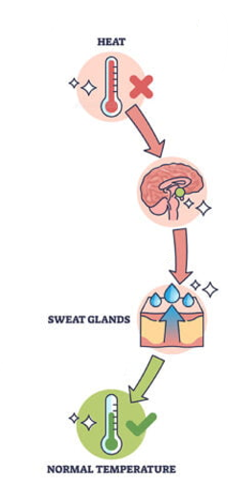
What happens when your body temperature increases?
Body temp. ↑
Sweat
Blood vessels expand (open)
Body temp. ↓

Slide 28
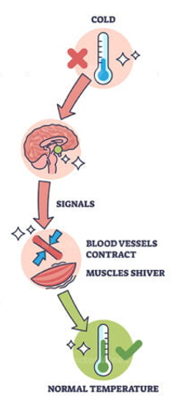
What happens when your body temperature decreases?
Body temp. ↓
- Muscles shiver
Blood vessels shrink (close)
Body temp. ↑

Slide 29
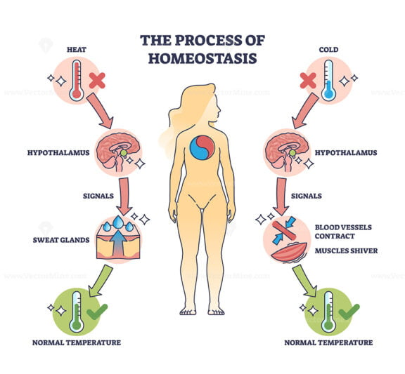
Describe the diagram below:

Slide 30

Homeostasis – Balance Activity
1. Stand and balance on one foot.
2. When you stand, be still. One foot on the ground. The other bent behind you.
3. The goal is to try to stand perfectly still.

Slide 31
Homeostasis - Balance
What did you feel when you were balancing on one foot?
Did it become more or less difficult to balance as time went on? Why do you think this is?
What did your feet do when you were balancing?
How does this activity like homeostasis?
How is this activity NOT actually homeostasis?

Slide 32
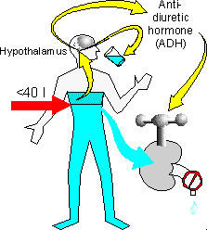
Homeostasis: Water Volume
Example: what happens when you drink too much water or not enough?

Slide 33
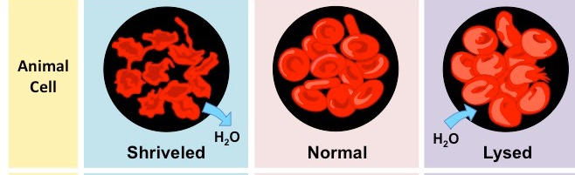
Example:
If a red blood cell, can’t control the amount of water inside, what will happen?

Slide 34
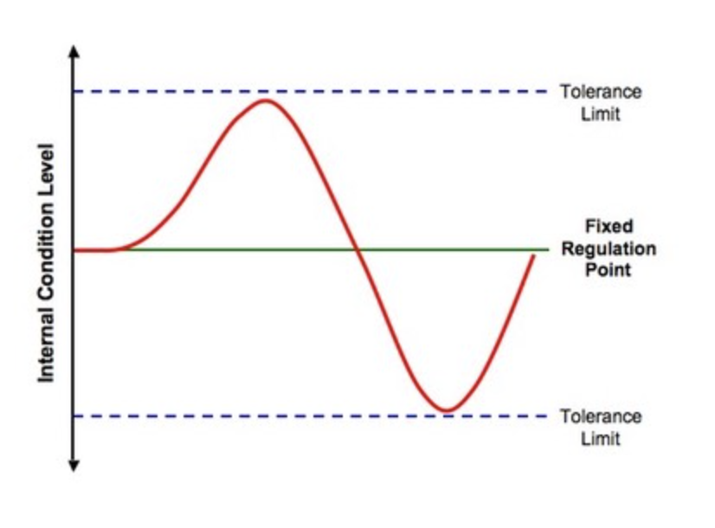
What is homeostasis?
Homeostasis= organisms' ability to maintain steady internal conditions

Slide 35
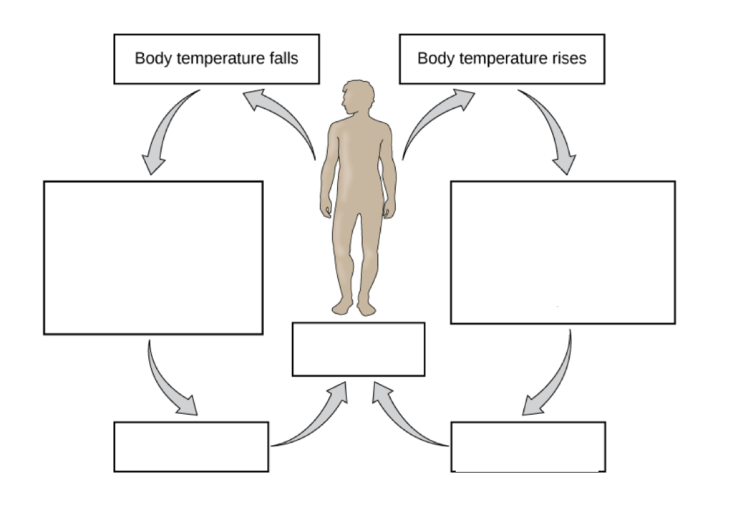
How does the body maintain body temperature homeostasis?

Slide 37
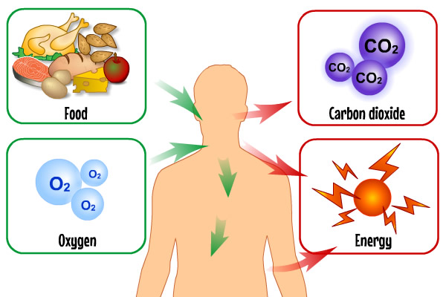
1. What materials does the body need to make energy?

Slide 38
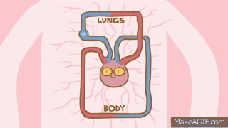
2. How do materials travel through the body?
The heart pumps the blood and oxygen throughout the body.

